Slide 1


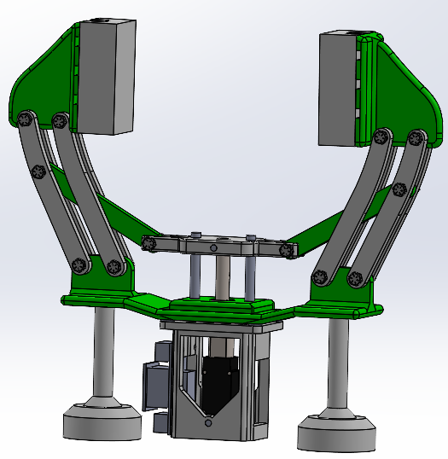
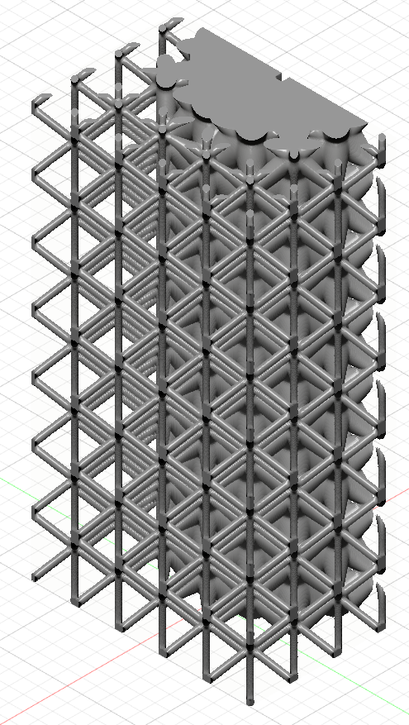
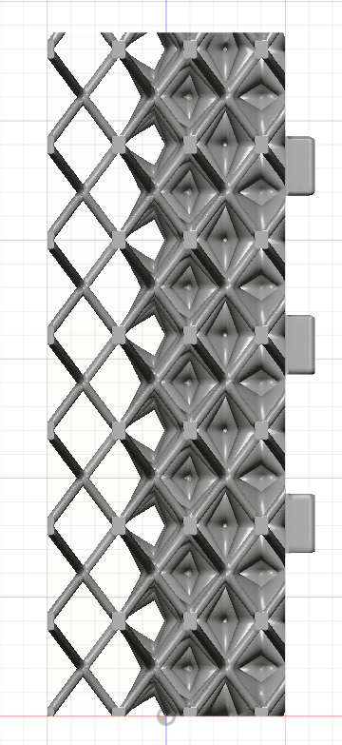
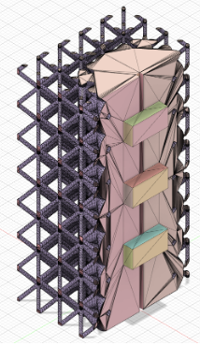
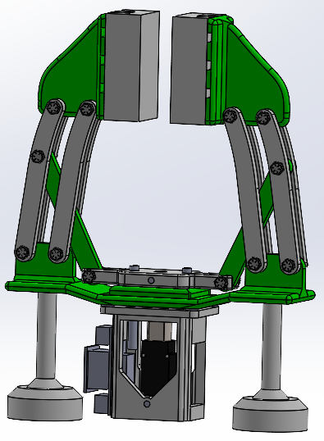
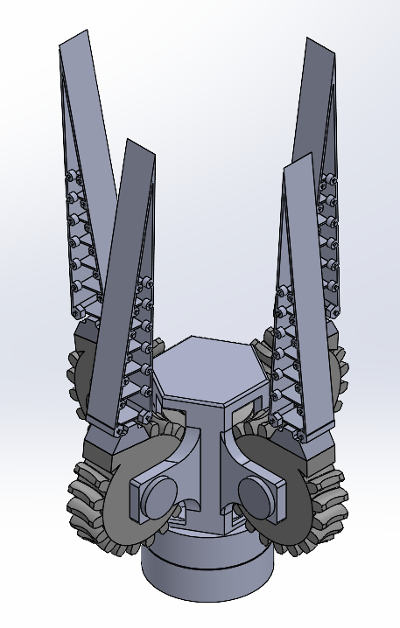
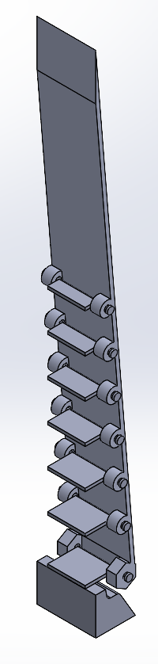
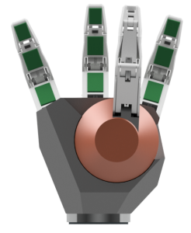
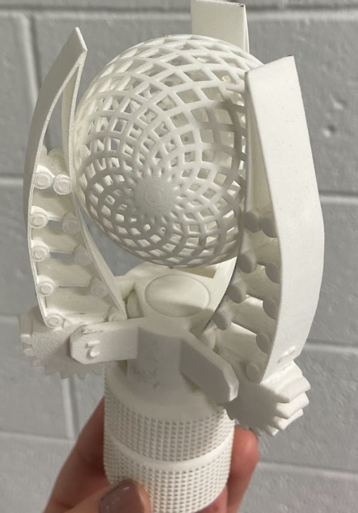
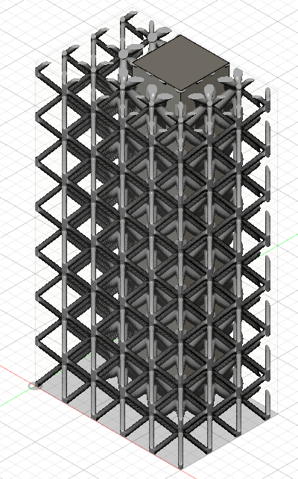
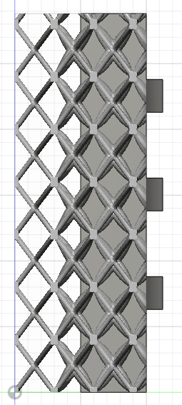
Satellite Gripper
Elizabeth Williams (MAE)
Ken Ruble
Mission
Final Design
Concept Development
As we advance our exploration of space and deploy an increasing number of satellites, it is imperative that we take responsibility for mitigating our environmental impact. I was challenged to design, model, manufacture, and test a satellite gripper intended for collecting space debris. CubeSats are the primary focus as they are the majority of space junk. While designing a satellite gripper system presents certain challenges, the potential rewards are substantial. This approach will not only reduce weight, but also enhance simplicity, improve efficiency, and decrease costs— qualities that are vital for successful space missions.
5
System:
Worm gear that drives four gears – all 90º apart, enabling a single actuator to control four degrees of freedom.
  While this prototype worked and was effective at gripping spherical objects, it proved less suitable for handling rigid geometries, such as CubeSats, which is our central target.
Linear actuator that drives two sets of two grippers with the sets parallel to each other. This allows one actuator to control two degrees of freedom. Although there are only two degrees on freedom, the parallel sets allows the system to grab the CubeSat on its sides or even diagonally.
Flexible Finger:
A hollow triangular structure with thin internal pivots. This allowed flexibility; however, manufacturing would be a hassle as there are seven pivots and four fingers.
A rectangular volumetric lattice with a solid core. The lattice perimeter allows for flexibility and slip resistance, and the solid core provides stability. Implementing the lattice structure will allow the fingers to ”hug” the object it is grabbing and will be able to conform to edges. The slots at the back of the finger were solely for assembling the prototype.
6
Figure 4. System at maximum closure.
Figure 3. System fully extended.
4
Research
Figure 5. Lattice Finger VJ, isometric and side view.
At the outset of this project, extensive research provided valuable insights, including the following:
  Most satellite grippers consist of joints within the fingers, resembling the structure of a human hand, see Figure 1.
  A worm gear actuating three gears proved to be an excellent choice for a satellite gripper system, offering flexibility to conform to complex shapes, see Figure 2.
  Rotating fingers are less suited for CubeSats; parallel grippers are more effective for handling CubeSats in various orientations.
  Lattice structure will conform to object’s shape allowing the gripper to grab irregular shapes.
  Flexible pivots within the finger structure allow for much flexibility.
Figure 6. Mesh of Lattice Finger VJ, isometric back view.
System:
  Driven by a linear actuator that extends and contracts with a switch.
  One actuator, two degrees of freedom.
  As the actuator contracts both grippers move toward each other, while extending the actuator causes the grippers to move apart.
  The maximum and minimum distances between the grippers are 5.57 in and 0.89 in, respectively.
  All components within the system were 3D printed with Bambu Lab X1C Printer using PLA (polylactic acid) filament.
Flexible Finger:
  Volumetric lattice including a solid core with a gradient that ends with a solidity of 0.15.
  The size of the finger itself is 1.5 in x 1.0 in x 2.8 in.
  There are three keys on the rear side, simply for prototyping, to ensure proper attachment to the system.
  The flexible finger reached variation J, representing a total of 10 distinct iterations of the flexible finger.
    The variations were due to testing different geometries for the lattice cells and exploring different solidity configurations (uniform or gradient solidity).
  The lattice finger was printed with an SLS (selective laser sintering) printer that used TPU (thermoplastic polyurethane) powder.
While load testing was not conducted due to time constraints, grasping tests confirmed that the system can securely handle objects of various geometries. Overall, I was able to design, model, prototype, and test a flexible satellite gripper, which can successfully grab a CubeSat in various orientations and other shapes as well.
7
Figure 7 (left). Satellite Gripper V2 and cross section view of gripper fingers, including pivots within structure.
Figure 1 (left). Underactuated finger system.
8
1
Figure 2 (right). Flexible system.
2
References
Mulsow, N. (2018). Gripper for iSAIRAS: A case study for robotic grasping in assistive systems [Conference paper]. Proceedings of the iSAIRAS 2018 Conference. German Research Center for Artificial Intelligence (DFKI). https://www.dfki.de/fileadmin/user_upload/import/9804_N_Mulsow_Gripper_iSAIRAS2018.pdf
M. L. (2023, March 3). 3D printable object (Thing: 5862229) [3D model]. Thingiverse. https://www.thingiverse.com/thing:5862229
Figure 8 (right). Lattice Finger VA, isometric and side view.

